Slide 1

CrowdStrike Falcon + Illumio
Leveraging Falcon network telemetry to accelerate host-based Zero Trust segmentation
Architecture overview | July 2026

Slide 2



Executive summary
Two platforms, complementary roles
CrowdStrike Falcon can supply the network connectivity telemetry that Illumio needs to build application dependency maps and accelerate Zero Trust segmentation — while Illumio remains the policy and enforcement engine.
Falcon sees
Illumio maps
Illumio enforces
The Falcon agent already observes every network connection on the host — IPs, ports, protocols, process context — with no extra agent to deploy.
The Illumio PCE ingests that telemetry to build application dependency maps and compute recommended allowlist segmentation policies.
Illumio VEN agents program the native host firewall (Windows Firewall, iptables/nftables) to enforce Zero Trust policy on each workload.

Slide 3
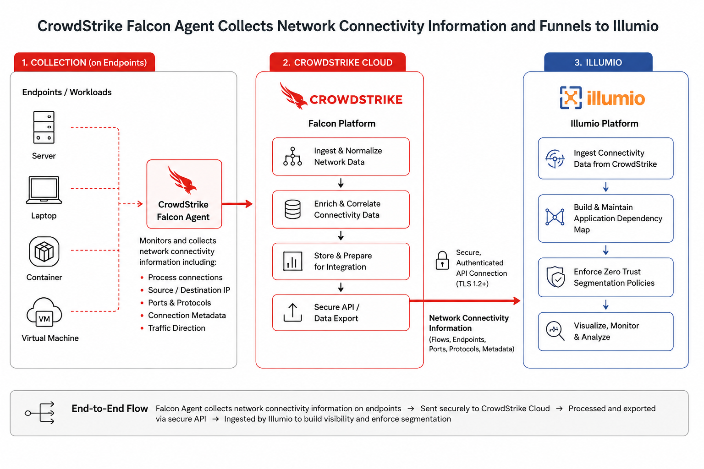


End-to-end architecture
1. Collection
Falcon agents on servers, laptops, containers and VMs monitor process connections, IPs, ports, protocols and traffic direction.
2. CrowdStrike cloud
The Falcon platform ingests, normalizes, enriches and stages connectivity data, then exports it over a secure, authenticated API (TLS 1.2+).
3. Illumio
Illumio ingests the flows, builds the application dependency map, enforces Zero Trust segmentation and provides ongoing monitoring.

Slide 4
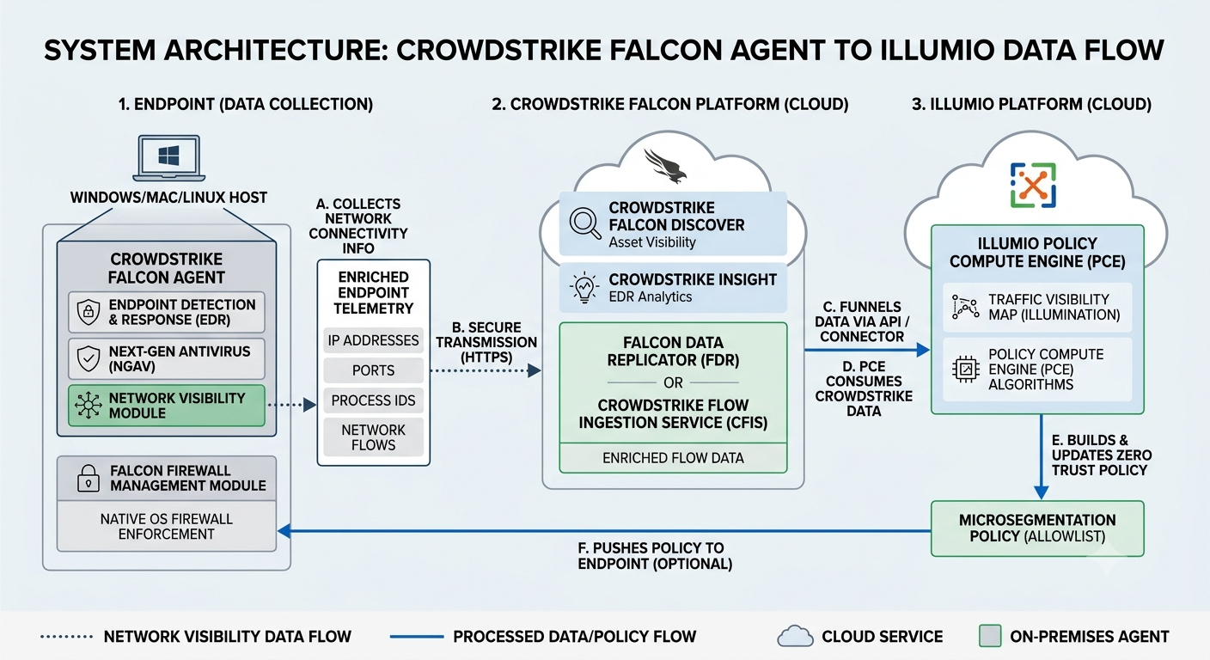
Data flow in detail
Falcon's network visibility module enriches endpoint telemetry (IPs, ports, process IDs, flows), streams it to the Falcon cloud, and Illumio's PCE consumes it via API/connector to build the traffic visibility map and compute allowlist microsegmentation policy.

Slide 5

What CrowdStrike Falcon provides
Rich endpoint telemetry, already deployed
Telemetry collected by Falcon agents
What this discovers
Process-to-process communications
Source and destination IP addresses
TCP/UDP ports and network protocols
Connection direction and metadata
DNS information and user context
Process lineage and asset metadata
Which applications actually communicate
Which ports are genuinely in use
East-west (lateral) traffic patterns
Unknown or undocumented dependencies
No new discovery tool, TAPs or SPAN ports required — reuse the Falcon deployment you already have.

Slide 6



How Illumio uses the telemetry
Shortening the learning period before Zero Trust enforcement
Ingest
Map
Model
Enforce
Connectivity data flows from the Falcon cloud into the Illumio PCE
>
PCE builds application dependency maps and communication patterns
>
Recommended allowlist policies are computed and simulated
>
Zero Trust segmentation applied at the host firewall
Example flows Illumio learns and locks down
SAP app server > TCP 1433 > SQL database
Web server > HTTPS 443 > API server
API server > TCP 5671 > MQ server
Only the required communications are permitted — everything else is denied by default.

Slide 7
Division of responsibilities
Falcon is an EDR platform; Illumio specializes in Zero Trust segmentation
Capability | CrowdStrike Falcon | Illumio
Endpoint telemetry | Yes | Yes (via VEN)
Network flow discovery | Yes | Yes
Application dependency mapping | Limited | Advanced
Microsegmentation policy design | Limited | Yes
Host firewall management | Basic | Yes
Zero Trust segmentation enforcement | No | Yes
Policy simulation | No | Yes
Ring-fencing applications | No | Yes

Slide 8
Typical enterprise deployment
Each platform does what it was designed for
CrowdStrike Falcon
Benefits
Endpoint security + network connectivity telemetry
No network TAPs or SPAN ports needed
Faster application dependency discovery
Reduced manual application mapping
Accelerated Zero Trust implementation
Improved east-west traffic visibility
Lower overhead by reusing the existing Falcon estate
v
Illumio Core (PCE)
Application dependency mapping + recommended policies
v
Illumio VEN agents
Policy distribution to each protected workload
v
Native host firewall
Windows Firewall / iptables / nftables enforce Zero Trust

Slide 9



Recommendation
Use Falcon telemetry to seed Illumio's dependency mapping. If Falcon is already deployed across your servers, this avoids duplicating discovery effort and shortens time-to-policy.
Deploy the Illumio VEN for enforcement. For host-based Zero Trust segmentation, the VEN controls the host firewall on protected workloads while Falcon continues to provide endpoint security and telemetry.
Key considerations. The Falcon-enforced path (Illumio Edge) targeted endpoints, not servers, and dates to ~2020 — confirm current support with Illumio before designing around it. Falcon Firewall Management and Data Replicator licensing is required for the integration.

